Slide 1

Actionable Data behind Digital Transformation: MDM & CDP
Kim Toomey
Solutions Consultant
June 2021

Slide 2




Corporate Overview
VISION: We enable fulfilling and happier lives for people everywhere by delivering single source of truth data that enables digital transformation
MISSION: We are the disruptive, digital first, SaaS platform that delivers mission critical, real time, trusted data at scale to customers and partners
FOUNDED: 2011
EMPLOYEES: 300 worldwide
INVESTORS: NEA, Sapphire Ventures, Crosslink Capital, 406 Ventures
INDUSTRIES: Life Sciences, Healthcare, Retail, CPG, Hi-Tech, Financial Services, Insurance, Travel & Hospitality
GROWTH: 4 years on INC. 5000 company with 275% revenue growth
CUSTOMER HIGHLIGHTS
2
9
of the top health- care services companies
of the top pharmaceutical companies
2
3
top hospitality brands
global luxury goods companies

Slide 3



Reimagine
Delighted
Customers
3
Notes:
At Reltio, we help our customers to understand their customers better than anyone else so they can thrive in the experience economy. But starting with improving customer interactions often leads to larger data requirements that drive your analytics, decision making, fulfillment or product offerings.

Slide 4
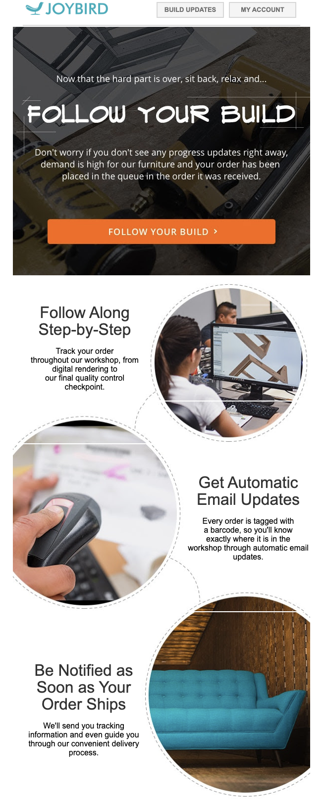
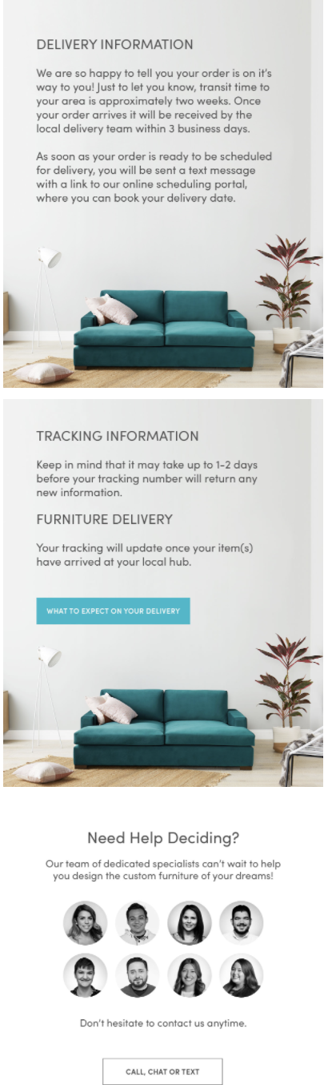
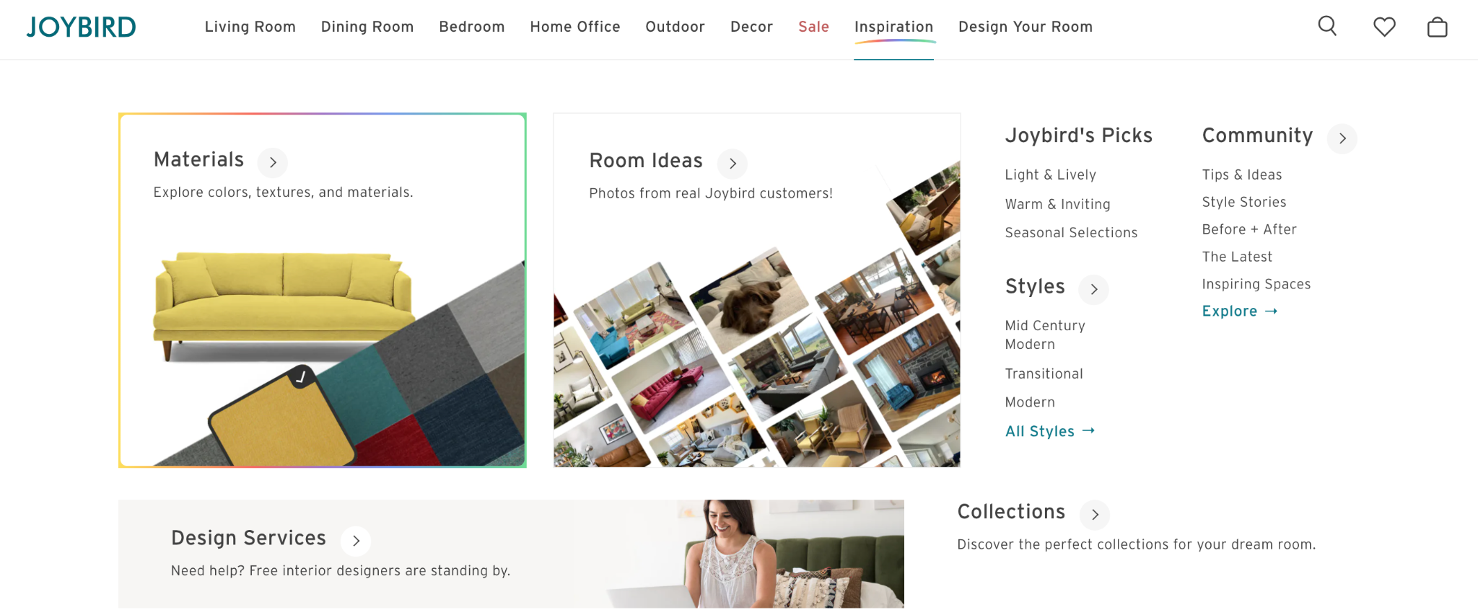
Data Within Digital Natives
“We’ve shaped our entire business around our customer” - Joybird
Notes:
What does it mean in 2021 to reimagine a delighted customer? Or to really drive digital transformation into a business? I’m sure we can all think of some examples, but I’m going to share one with you today. Like many people - I was stuck in my house last year and decided to tackle some home improvement projects and upgrade some of the Ikea furniture I’ve been lugging around for far too long. And I bought one thing from this furniture store - Joybird. They’re a fascinating company that was built to disrupt the furniture industry and change the way you buy furniture, and is truly a digital native furniture retailer. Their desire to delight the customer at every interaction is what companies should be thinking about - and how can we use data and digitally connect all these consumer touchpoints to deliver an exceptional experience.

Slide 5
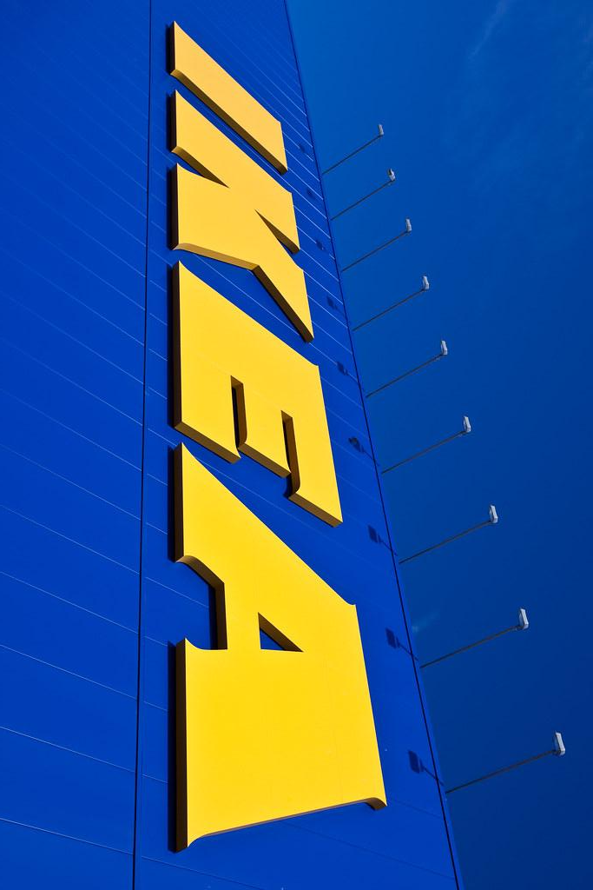
Digital Transformation at IKEA
“We are transforming our business: We are exploring potential new offers to customers, new ways to bring our offers to customers, and new ways to operate our business. And in order to be successful, digital needs to be embedded in every aspect of IKEA.
Digital is a way of working, making decisions, and managing the company.”
https://hbr.org/2021/06/inside-ikeas-digital-transformation
Notes:
Now, this process is a bit like an iceberg. At the top of the iceberg, we have the customer needs and adaptation — revamping everything around customer interaction and new purchasing journeys — and under the surface we are making huge changes to our business and operating model. And what is under the surface is a much bigger change than what we see above.

Slide 6
Digital transformation is the integration of digital technology into all areas of a business, fundamentally changing how you operate and deliver value to customers. It's also a cultural change that requires organizations to continually challenge the status quo, experiment, and get comfortable with failure.
Notes:
And data is currency in this ecosystem. For years, companies have been told that data is king - you need web analytics, measurable advertising campaigns, first party data, third party data, SDKs, CRMs, ESPs
And then we had data everywhere. Warehouses, lakes, reports and dashaboards.
And about 7 years ago, we saw the first of CDP’s. Customer Data platforms. And as technologies have advanced and more and more businesses are looking to the cloud for software solutions, we’re often faced with a noisy ecosystem that can be hard to differentiate vendor A from vendor B.
Today we’re going to take a look at the intersection of these technologies - in Master data management solutions alongside Customer Data platforms.

Slide 7



Customer Experience is a Mandate in Experience Economy
64%
84%
73%
Finds customer experience more important than price while making purchasing decisions¹
Companies that work to improve their customer experience reported an increase in their revenue²
of consumers say a good experience is key in influencing their brand loyalties³
1. Gartner: Importance of Customer Experience Is on the Rise; Marketing Is on the Hook
2. https://www.prnewswire.com/news-releases/new-research-from-dimension-data-reveals-uncomfortable-cx-truths-300433878.html – 84% of companies that work to improve their customer experience report an increase in their revenue
3. https://www.pwc.com/future-of-cx 73% of consumers say a good experience is key in influencing their brand loyalties
Notes:
Gartner: Importance of Customer Experience Is on the Rise; Marketing Is on the Hook
https://www.prnewswire.com/news-releases/new-research-from-dimension-data-reveals-uncomfortable-cx-truths-300433878.html – 84% of companies that work to improve their customer experience report an increase in their revenue
https://www.pwc.com/future-of-cx 73% of consumers say a good experience is key in influencing their brand loyalties

Slide 8
Pillars of Digital Transformation
Digital Experiences
Digital Operations
Digital Innovation
How your company is creating new digitally influenced products and services.
Omni-channel, coordinated communication.
Personalization done accurately and at scale.
Adoption of modern platforms
Automation of processes
Cloud infrastructure
Usage of AI/ML
Intersection of Digital Experiences and Digital Operations driven by the C-Level for the business
Measurable impacts to the overall business.

Slide 9
Gartner Defines MDM As:
Gartner’s definition is, “Master data management (MDM) is a technology-enabled discipline in which business and IT work together to ensure the uniformity, accuracy, stewardship, semantic consistency and accountability of the enterprise’s official shared master data assets. Master data is the consistent and uniform set of identifiers and extended attributes that describes the core entities of the enterprise including customers, prospects, citizens, suppliers, sites, hierarchies and chart of accounts.”

Slide 10
Gartner Defines CDP As:
A customer data platform is a marketing system that unifies a company's customer data from marketing and other channels to enable customer modeling and optimize the timing and targeting of messages and offers.

Slide 11
Customer Data Platforms come in different flavors
Infrastructure CDP
Marketing Clouds
Omni-Channel Decision Engines
Real-time collection of first-party customer data across a variety of (primarily) marketing tools.
Identity Resolution for customers from anonymous signals to unified record.
Route data from one tool to another.
CDP Module offering as part of an integrated cloud marketing suite.
Native Machine Learning capabilities and behavioral segmentation
Omni-channel journey mapping capabilities

Slide 12

Reltio & CDP Working Together
z
RELTIO
CUSTOMER DATA PLATFORM
Data Management: Ingest first-party, individual-level customer data
From online and offline sources
In real time, on-prem/Cloud
Unlimited storage and data persistence
First-party identifiers and attributes
Combine data from disparate sources including third-party data providers
Machine Learning Data Catalog
Profile Unification: Consolidate profiles at person level & connect attributes to identities
Link multiple devices to a single, personally identified individual
De-duplicate customer records
Segmentation: Interface for marketer to create and manage segments
Rule-based segment creation
Automated segment discovery
Predictive analytics
Propensity models
Import and deploy custom models built in MDM
Activation: Segments sent with activation instructions to execute:
Email campaigns
Mobile messaging and advertising
Consumer Profile
Notes:
Danny
Explain that CDP is an Application with a Marketing Audience.
CDP’s are saying that they can be a true Customer Master bleeding into our area
Will also talk about Customer Journey as key use case for them - they mean in a marketing sense - outbound reach/touches etc..

Slide 13
Considerations for Technology

Slide 14
Zoom In On Customer Data
Customers = People
Technology inherently will have a different definition of a “person”
Digital Identity
Unique Identifier
Verifiable Human
What information do you need about your customer?
Implications of erroneous data - inferred or consented
Privacy considerations – how are you allowed to use this information?
Notes:
For today’s conversations, we’re focused on first-party, customer data.

Slide 15
Who Within Your Organization Needs Access?
MDM
IT-Owned Technology
Centralized data to distribute throughout the organization.
Day to day users leverage MDM to improve data quality, enforce governance & distribute data to appropriate teams and systems
CDP
Marketing-Owned Technology
Influenced by MarTech team, IT or Data teams, depending on the organization
Day to day users leverage CDP to create customer segments & coordinate customer data into final-mile delivery systems

Slide 16
What Use Cases are your Empowering w/ Customer Data?
MDM
Analytical and Operational use-cases within any department requiring cleansed and accurate data
Simplify compliance and data governance
Agility in data models and relationships to quickly adapt to changing business requirements
CDP
Primarily marketing-driven campaigns to improve campaign performance or deliver net-new capabilities in targeting
Acquire more consented first-party data through intelligent anonymous targeting
Strive towards 1:1 personalization through segmentation

Slide 17
Personalization at Scale
Segmentation as a strategy becomes inherently problematic:
Are your downstream tools equipped to deliver on your segmentation requirements?
How many variations can your marketing team currently support?
1:1 Personalization requires coordinated real-time pipelines of data to be dynamically returned to downstream systems and templates.

Slide 18
Considerations
Data and IT Maturity within your organization
People Resources
Existing & Future Technology Stack

Slide 19

Organizational & Data Maturity
I don’t have enough first-party data
My data is siloed across sources and I don’t have a unified view of my customer
The data I have is inconsistent and inaccurate
I can’t access the data in a scalable and efficient way
Notes:
Chicken or the egg- what comes first, MDM or CDP?
These are often some of the first business challenges that are brought up – and both CDP and MDM can be solutions to these. The next level deeper is what do I want to do with this data once I have these challenges solved? Having a guiding north star to align to will help you discern where to start and where you want to end up.

Slide 20
System Ownership
MDM
CDP
Day to Day Owner
IT/Data Architects
Data Governance
Influencers
Reporting/Analytics
Product
Sales/Marketing
Day to Day Owner
Marketing Technologist
Audience Manager
Influencers
Web Development
Product
Reporting/Analytics
IT/Data Architects

Slide 21
A Day In The Life
I have customer data at a marketer’s fingertips that can easily be grouped into segments to power customized experiences.
The understanding I have of my customer is accurate, robust and available to n number of systems in real-time.
Notes:
When you get to the boots on the ground phase of your project - what are the steps that need to be taken to accomplish you use-case? This should be very practical - put yourself in the shoes of an Individual contributor who would be supporting these business objectives. For a marketer - this is going to include things like, building xyz audiences segments to support my campaign. But does it need to go back even further into the project lineage? Where did this customer data come from? Is it reliable? Are we allowed to use it? What else do I know about this customer that can help me make a better decision? Those question are better answered by an MDM solution.

Slide 22
Building Into Your Ecosystem
Where is my customer data coming from?
Where does my customer data need to go?
Notes:
What other technologies do you have in place? What is staying and you are future-proofing with, vs. what is in consideration for an upgrade?
Overall, you want both your MDM and CDP solutions to be compatible with your architecture - meaning open APIs that you can build upon, existing integration frameworks. Dive deep into how robust pre-configured integrations are with your CDP vendor if there are existing technologies you know are key to this entire workflow. If email personalization is a key-use case for your CDP project, think through exactly the type of campaigns you want to implement and ensure both your vendors can support it.
Do you need to build something more custom yourself?
If thats the case, look at more specialized tools that

Slide 23

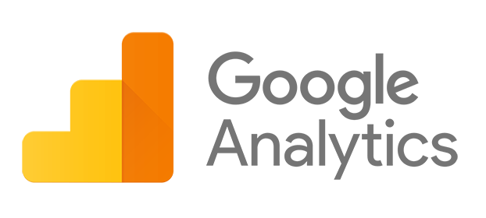



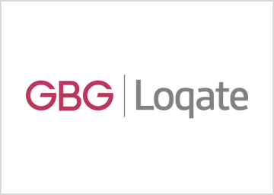
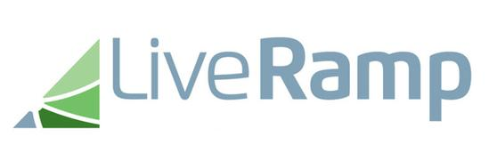
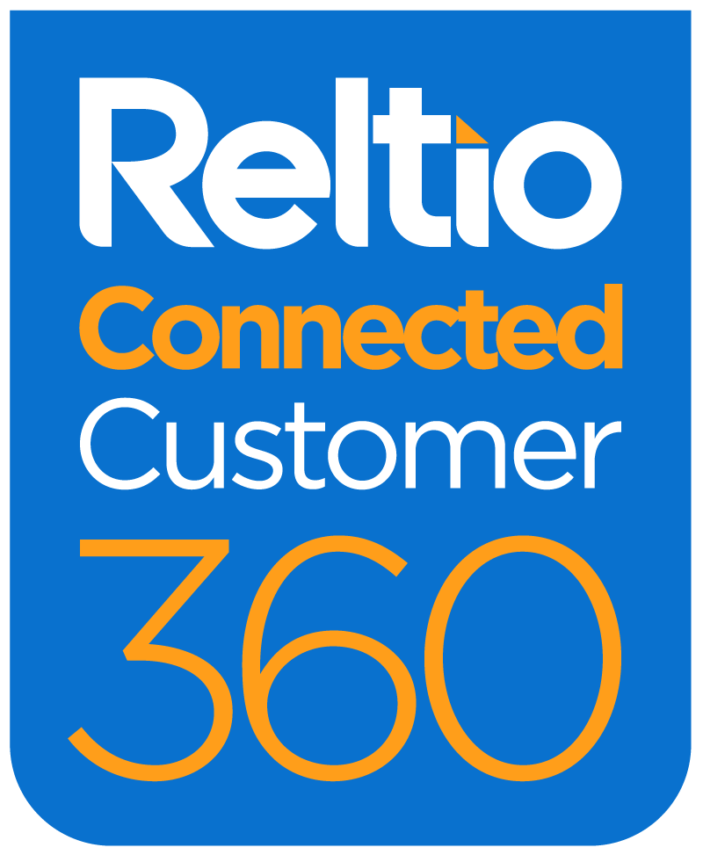
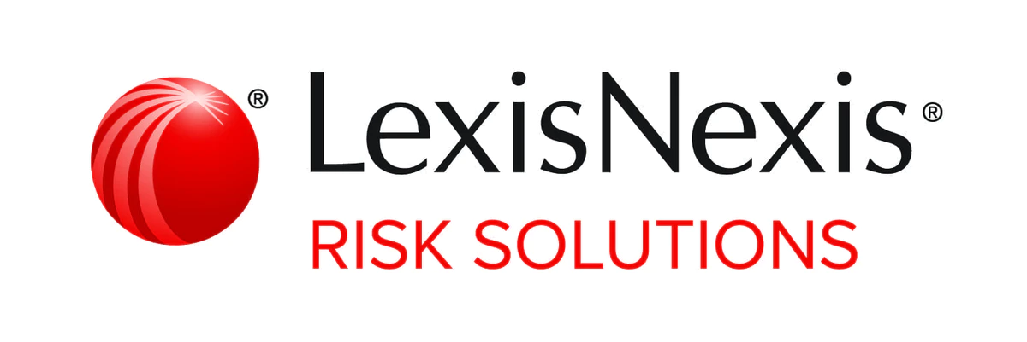
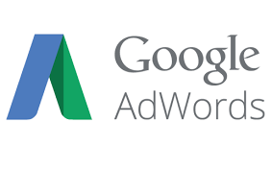

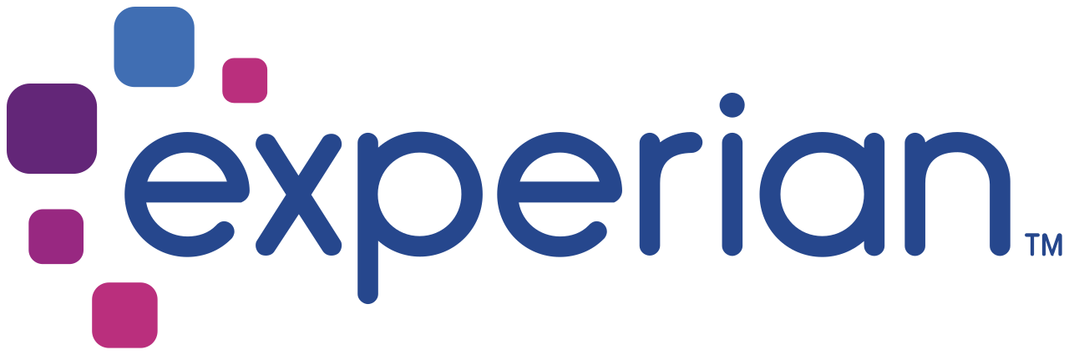

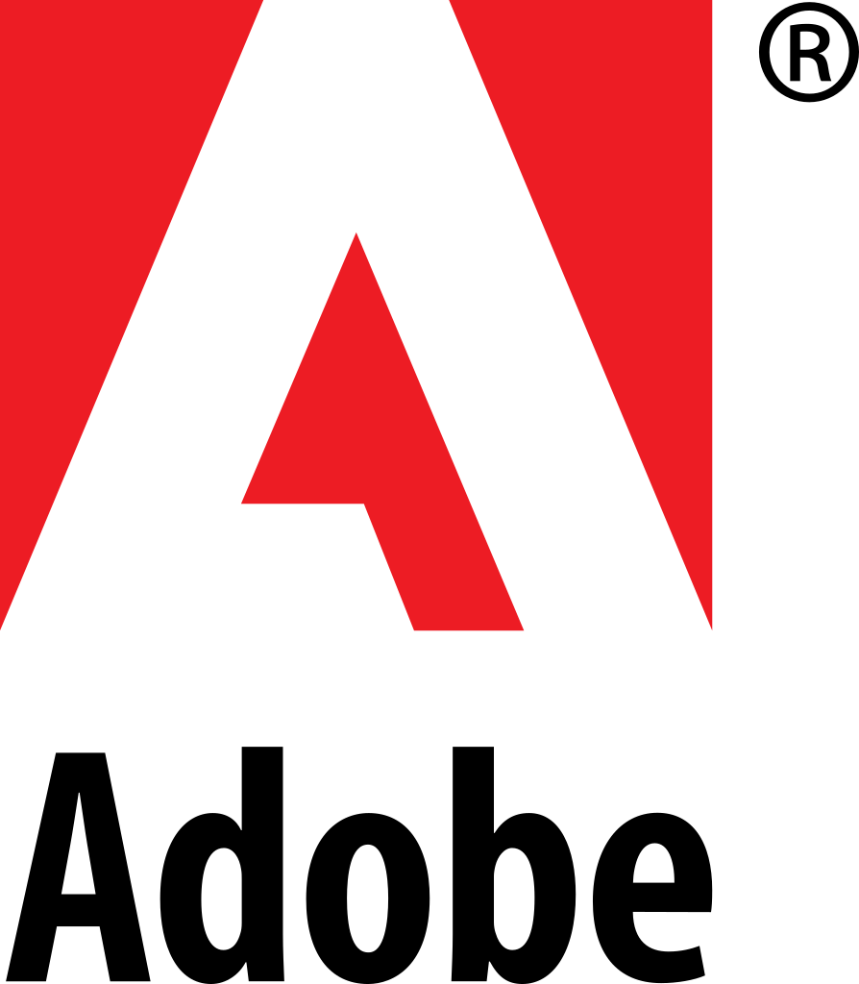
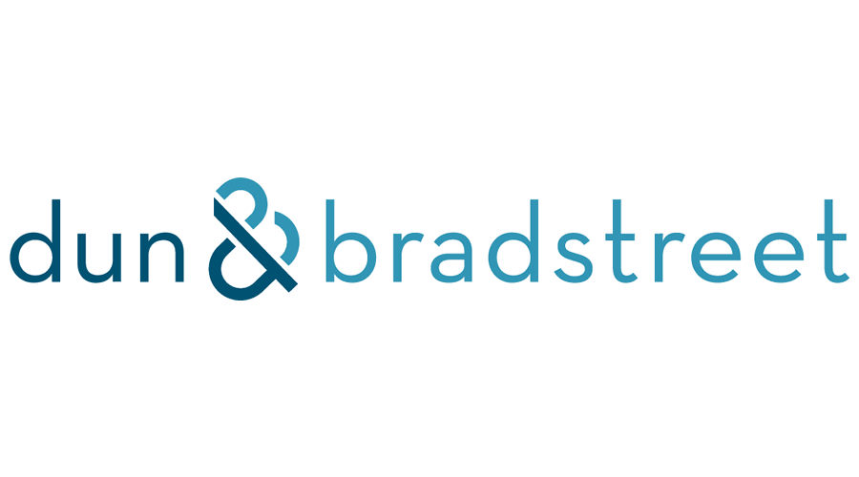
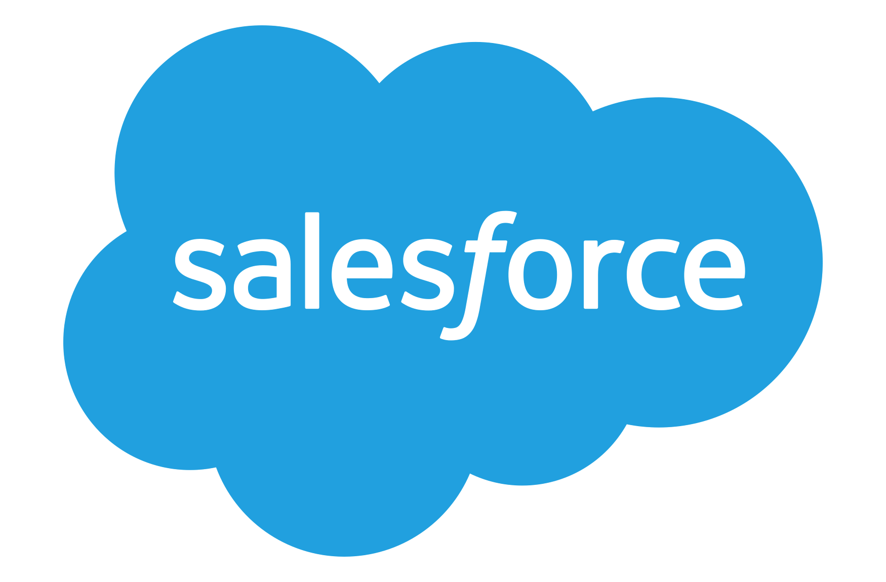



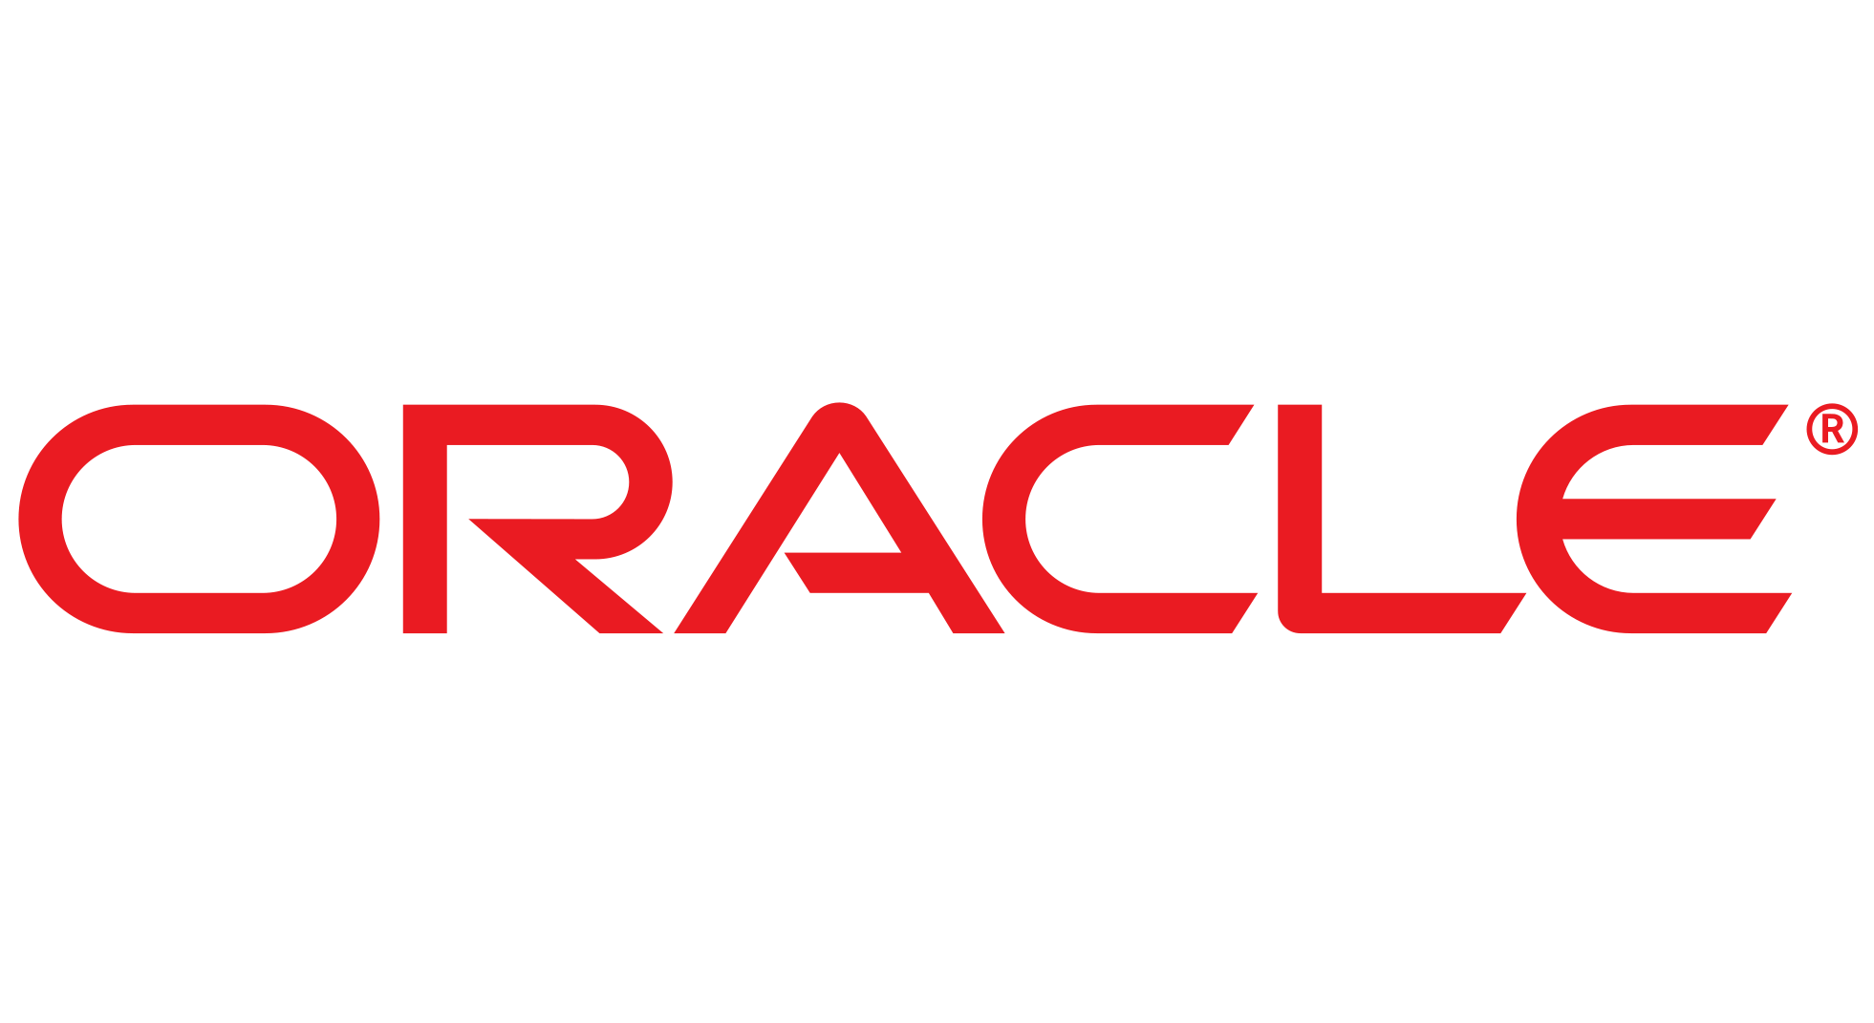
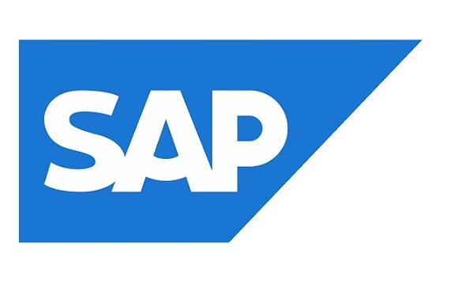


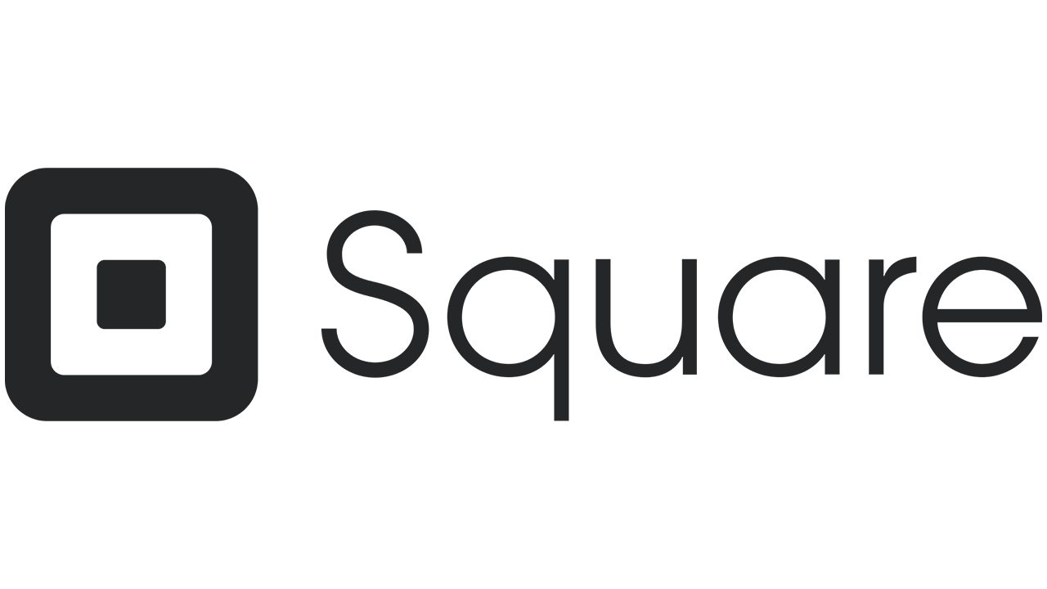
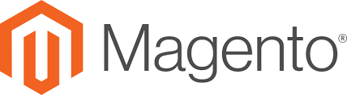

Reltio + CDP Integration—Deep Customer Profiles to Feed MarTech
Data Lakes / Warehouses / Marts
3rd Party Data Enrichments
Campaign Execution
Reporting
Analytics
AI/ML
Mastered and Enriched Profiles, relationships, consent & interactions
Derived Scores, Segments, Recommendations
Derived Scores, Segments, Recommendations
Advertising
Social
CDP
Audiences, Triggers and Decisions
Email
Mastered and Enriched Profiles, relationships, consent & interactions
Scoring, Activation, Orchestration
Profiles: Consumer, Location, Org/Customers, Product), Relationships & Interactions
Standardization, Cleansing, Deduping
Segmentation
Consent, GDPR, Audit, History, Lineage
Derived Scores
Click-stream
Capture
Partner & Purchased Data
Source Data & Interactions
Scores, Segments, Recommendations
CRM
ERP
Clienteling
POS
eCommerce
Loyalty
Operational Systems

Slide 24
Advantage Over CDP-Only tool
 |  | Reltio Cloud | CDP
Leading Multi-Domain Enterprise Data Platform | Industry-leading modern enterprise data management platform that brings together customer data from all sources and formats. Leader in Forrester Wave for Master Data Management (MDM).
Built-in Enterprise Level Security & Compliance | Continuous and ongoing compliance. Role-based access at the attribute level. Granular attribute level audit and history of all data touchpoints and changes. GDPR ready.
Capture & Model Multi-domain Relationships | Uncover many-to-many relationships across customers, households, employees, products, loyalty cards, restaurants, properties, etc.
Source of Truth for Enterprise-wide Operations & Analytics | Bring all internal, external, and 3rd-party data together. Provision the reliable data with measurable data quality to all enterprise downstream operational and analytics applications.
Contextual Information for All Users, beyond marketing | Deliver role-based, contextual and consumer grade applications for business users across marketing, sales, finance, suppliers, call centers, promotions and events, etc.
Agility at Speed of Your Business | Configurable in real-time, radically simplified data model, adaptable to business needs. Quickly add new data sources and attributes.

Slide 25

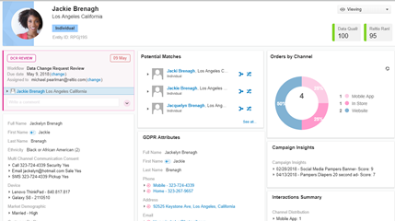

Reltio & CDP: Better Together
Feed mastered customer records into CDP
Highly compliant & accurate
Persistent unique identifier
Progressively stitch updates
Store thin-anonymous records in CDP
Leverage MDM as source when merge activities occur
Customer Record Management vs. Audience Management

Slide 26







www.reltio.com
www.reltio.com/contact-us
+1 (855) 360-DATA
linkedin.com/company/reltio-inc
@Reltio
facebook.com/ReltioHub

Slide 27
Kim Toomey
Solutions Consultant
kim.toomey@reltio.com
https://www.linkedin.com/in/kimtoomey/

